Slide 1
Communication Skills for Engineers (COMM 402-EC10)
Week 3 – Sessions 5&6
Prepared by Stefany Salemeh

Slide 2
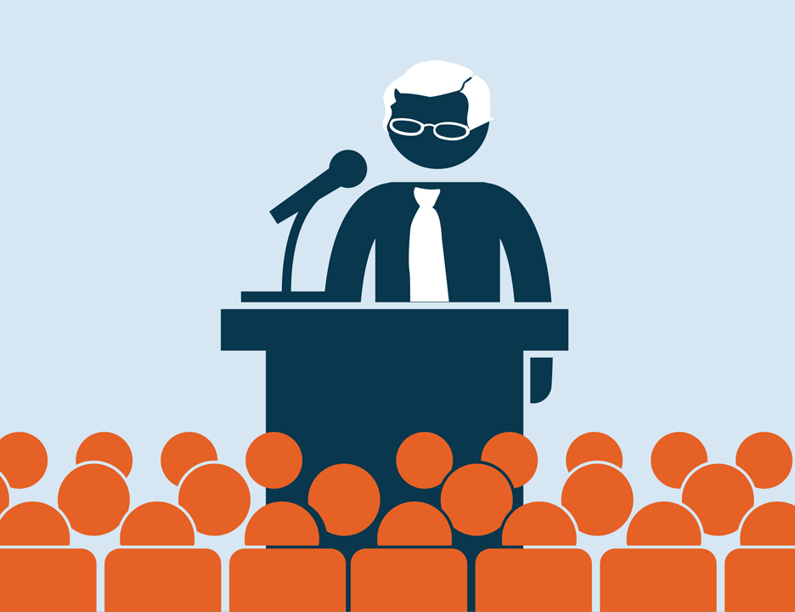
General Purpose of a Speech
To inform
To persuade
To entertain

Slide 3
The informative speech will be your midterm.
You will be presenting in pairs (6-8 mins).

Slide 4
Informative Speech
One of your first classroom assignments probably will be to deliver an informative speech in which you will act as a lecturer or teacher. You may describe an object, show how something works, report on an event, explain a concept. Your aim will be to convey knowledge and understanding— not to advocate a cause.
Your speech will be judged in light of three general criteria:
Is the information communicated accurately?
Is the information communicated clearly?
Is the information made meaningful and interesting to the audience?

Slide 5
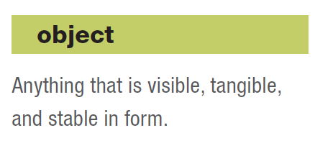
Types of Informative Speeches
Speeches about Objects
As the word is used here, “objects” include anything that is visible, tangible, and stable in form. Objects may have moving parts or be alive; they may include places, structures, animals, even people. Here are examples of subjects for speeches about objects:
Legos (To inform my audience about the worldwide fascination with Legos.)
Service dogs (To inform my audience about three major kinds of service dogs.)

Slide 6
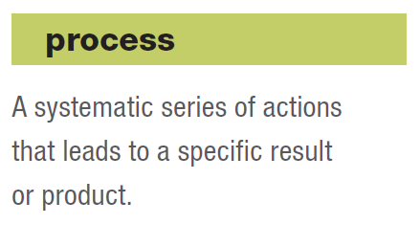
Speeches about Processes
A process is a systematic series of actions that leads to a specific result or product. Speeches about processes explain how something is made, how something is done, or how something works. Here are examples of good specific purpose statements for speeches about processes:
Floods (To inform my audience how flash floods develop.)
CV (To inform my audience how to write an effective job resumé.)

Slide 7
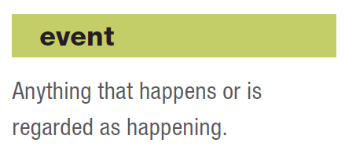
Speeches about Events
The Random House Dictionary defines an event as “anything that happens or is regarded as happening.” By this definition, the following are examples of suitable topics for informative speeches about events:
Paralympics (To inform my audience about the history of the Paralympics.)
Mardi Gras (To inform my audience about three aspects of the Mardi Gras celebration in New Orleans.)

Slide 8
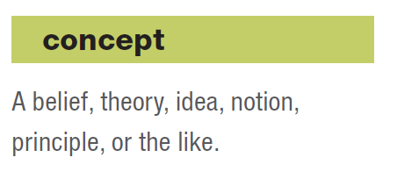
Speeches about Concepts
Concepts include beliefs, theories, ideas, principles, and the like. They are more abstract than objects, processes, or events. The following are examples of subjects for speeches about concepts:
Non-violent resistance (To inform my audience about the basic principles of nonviolent resistance.)
Homeschooling (To inform my audience about different philosophies of homeschooling.)

Slide 9
Topic: “Electrical Vehicle”
How would the same topic fit in the different categories?
Object
Process
Event
Concept

Slide 10
Free-Writing Activity
Take a few minutes to jot down a few topic ideas underneath the different categories:
- Objects
- Processes
- Events
- Concepts
Write about whatever comes to mind. Writing anything and everything. Don’t think about it just write.

Slide 11

When selecting a topic, follow the motto:
“Teach me something new!”
(should be related to your major)

Slide 12
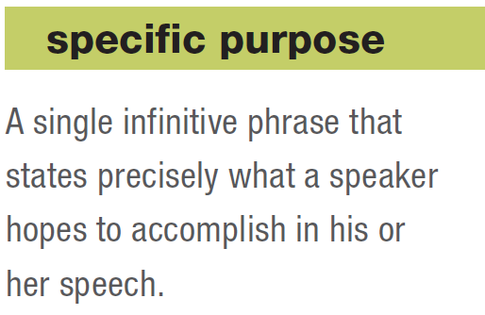
Establish:
Topic:
General Purpose:
Specific Purpose:

Slide 13
Example:
Topic: Electric Vehicles
General Purpose: To inform
Specific Purpose: To inform my audience how electric vehicles are constructed.

Slide 14
Example:
Topic: Artificial Intelligence
General Purpose: To inform
Specific Purpose: To inform my audience about artificial intelligence.

Slide 15
Example:
Topic: Music Therapy
General Purpose: To inform
Specific Purpose: To inform my audience how music therapy helps people with psychological or cognitive disabilities.

Slide 16
Example:
Topic: Cybersecurity
General Purpose: To inform
Specific Purpose: To inform my audience about common online threats and how they occur.

Slide 17
Exercise
Here are several specific purpose statements for classroom speeches. Identify the problem (or problems) with each.
To inform my audience about Portugal.
Donate blood.
To inform my audience why square grooves are superior to U-shaped grooves on golf clubs.
What is the Great Pacific Garbage Patch?
To inform my audience how to register for classes.

Slide 18
Informative Speech Example
https://www.youtube.com/watch?v=StPSgqwCnVk&t=34s
https://cornerstone.lib.mnsu.edu/afa-niet-recordings/2018/informative-speaking/4/
https://www.youtube.com/watch?v=dxd9xGH09lg

Slide 19
Same Topic, Different Audience
Specific Purpose: To inform my audience about common online threats and how they occur.
Audience: Business Investors
To inform my audience about common online threats and how they can impact financial assets, data integrity, and business continuity.
Audience: Engineering Professionals
To inform my audience about common online threats targeting digital systems and the mechanisms through which these attacks exploit technical vulnerabilities.

Slide 20

Write your specific purpose
Is there an interest in the audience to know about your topic/purpose?

Slide 21
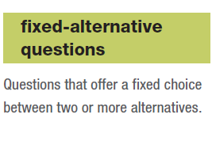
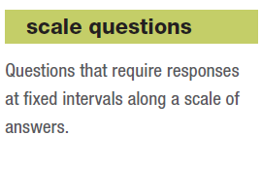
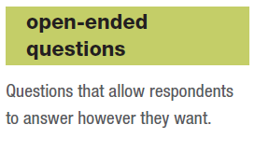
Getting to know your audience –
Developing a questionnaire to ensure that your speech is audience-centered

Slide 22
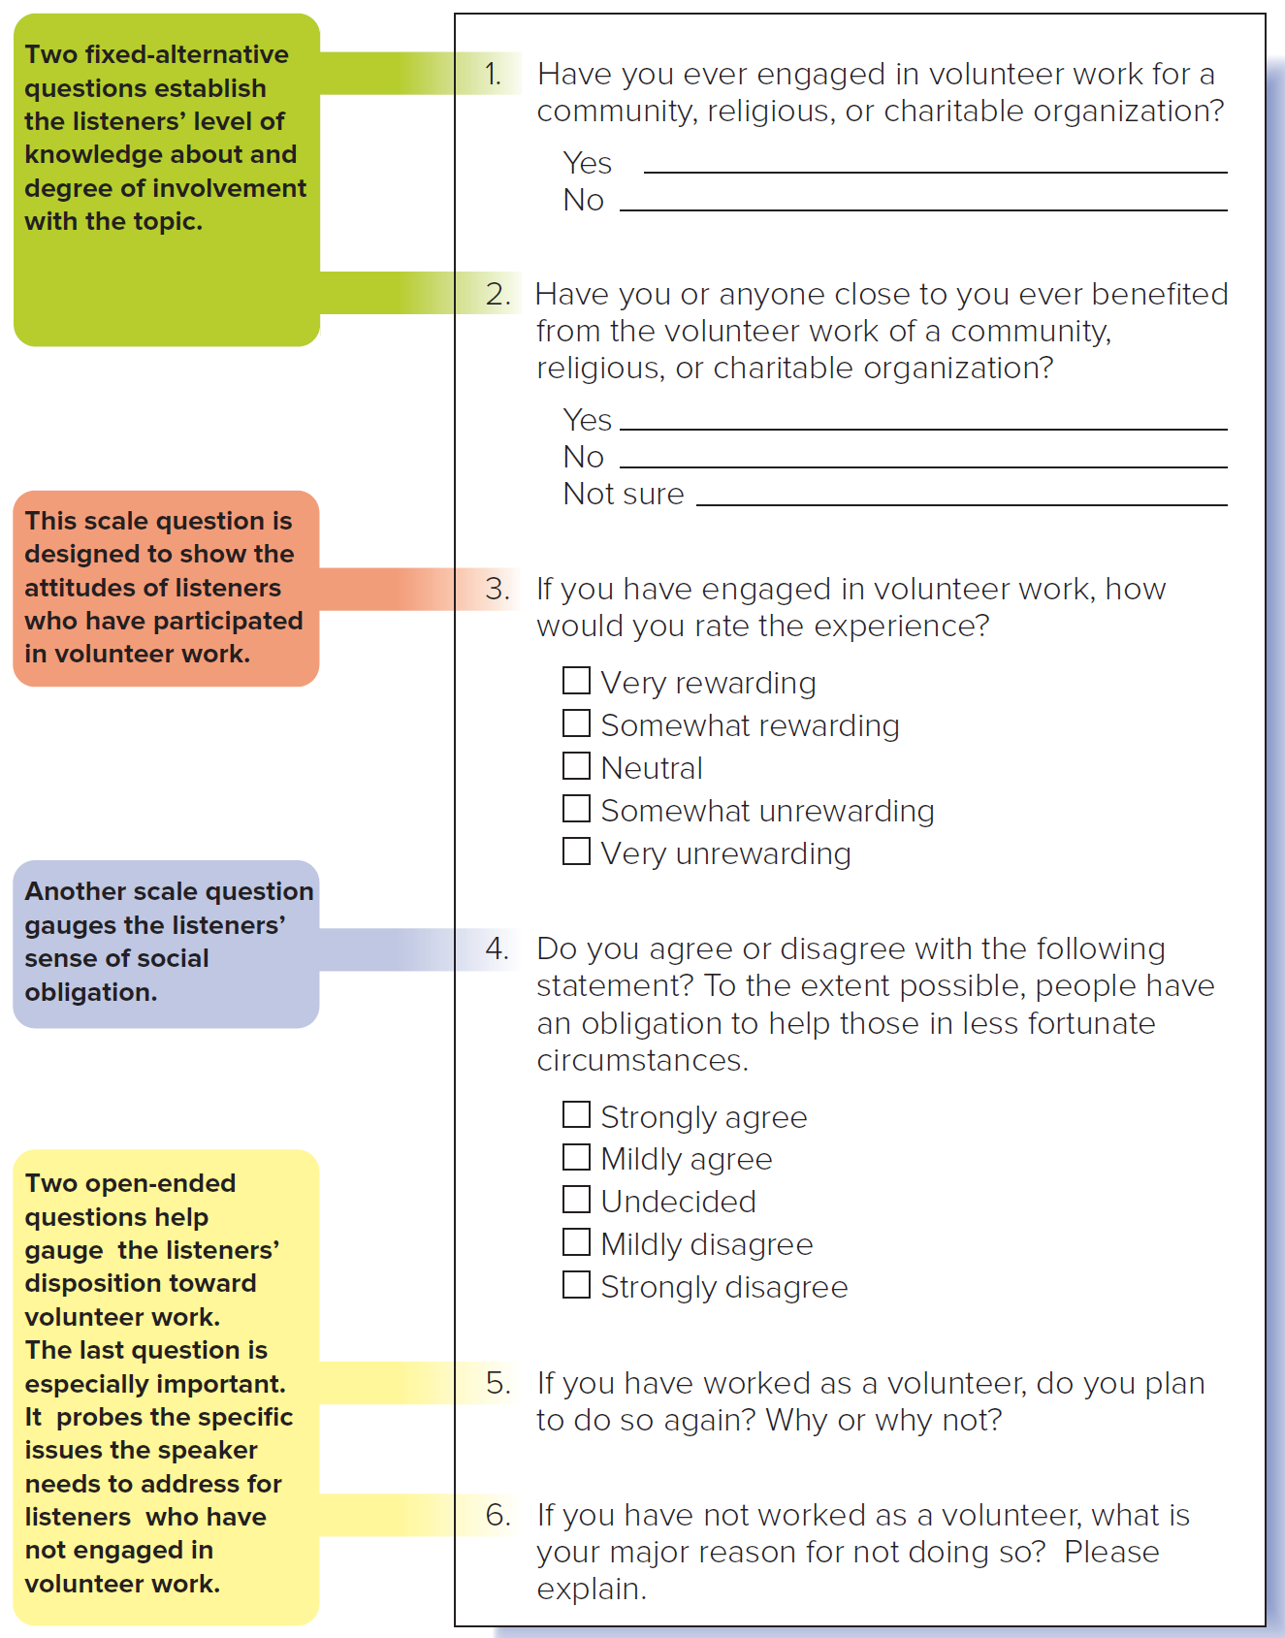

Slide 23

Activity:
-You will have 5-7 minutes to create a questionnaire for your topic using Google Forms
- You will then post your survey link to Teams and then answer your classmates’ surveys.
- Determine if your topic is audience-centered or if you should come-up with a new one?

Slide 24
Now you decide…
Based on my audience’s responses,
I will --------- my topic because -------
Options for first blank: keep / narrow / change

Slide 25
Imagine that you run into a friend on your way to speech class.
She says, “I have to dash to my history lecture, but I hear you’re giving a speech today. Can you tell me the gist of it in one sentence?”
“Sure,” you reply. “America’s prison system suffers from three major problems—overcrowding of inmates, lack of effective rehabilitation programs, and high expense to taxpayers.”

Slide 26
Your answer is the central idea of your speech. It is more precise than your topic (America’s prison system) or your specific purpose statement (“To inform my audience of the three major problems facing America’s prison system”). By stating exactly what the three major problems are, the central idea sums up your speech in a single sentence.

Slide 27
Exercise:
Identify the problem with each central idea and figure out how each might be phrased more effectively.
Ineffective: Paying college athletes a monthly stipend is a good idea.
Ineffective: Problems of fad diets.
Ineffective: What are nanorobots?
Ineffective: South Africa is an awesome place for a vacation.

Slide 28

What is the Central Idea?
The specific purpose of a speech is what you hope to accomplish. The central idea is a concise statement of what you expect to say. Sometimes it is called the thesis statement, the subject sentence, or the major thought.

Slide 29
